Slide 1
Kubernetes Objects

Slide 2

Kubernetes Namespace?
In Kubernetes, namespaces provides a mechanism for isolating groups of resources within a single cluster.
Initial Namespaces,
Default
Kube-node-lease
Kube-public
Kube-system
When a Service is created, a corresponding DNS entry is also created.
This entry is of the form <service-name>.<namespace-name>.svc.cluster.local,
Which means that if a container only uses <service-name>, it will resolve to the service which is local to a namespace.

Slide 3

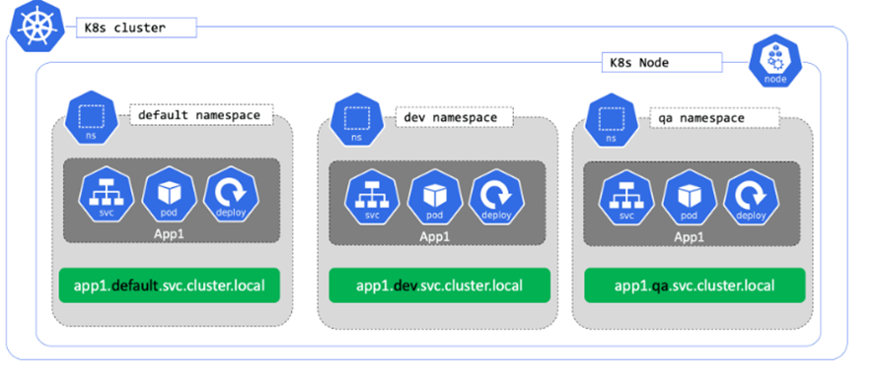
Namespace structure

Slide 4
PODs
Requirements to have multi-container POD
Tightly coupled applications
Scheduling Process together
Requirements on some shared resources
Usually one is generating data while the other process consumes
POD
Same Cggroup and namespaces are shared across all containers in a POD
Shared localhost interface
Shared localhost interface
Main Container
Supporting Container
Supporting Container
192.168.1.2:80
192.168.1.3:80
192.168.1.4:80
POD1
192.168.1.2
POD2
192.168.1.3
POD3
192.168.1.4

Slide 5
Multi-Container POD
Init Containers
A Pod can have multiple containers running apps within it, but it can also have one or more init containers, which are run before the app containers are started.
Init containers are exactly like regular containers, except:
Init containers always run to completion.
Each init container must complete successfully before the next one starts.
Sidecar containers
The secondary containers that run along with the main application container within the same Pod. These containers are used to enhance or to extend the functionality of the primary app container by providing additional services, or functionality such as logging, monitoring, security, or data synchronization, without directly altering the primary application code.

Slide 6
POD Health
LivenessProbe:
A livenessProbe continuously runs a diagnostic check on the container.
The livenessProbe is set in the specification of a container. So if there are multiple containers in a POD, then will have to set livenessProbe on every container if we want to know about the status of the container running App.
On failure the kubelet will try to restart the container as per the restartPolicy.
This gives Kubernetes a better understanding of applications inside containers.
ReadinessProbe:
A readinessProbe continuous runs diagnostic check on the container.
This setting is again the per container setting
The container will not receive traffic until the readinessProbe succeeds.
On failure of the container inside a POD, the POD is removed from the Load Balancing.
This makes sure that the application will not get into errors.
StartupProb:
startupProbe continuously runs a diagnostic check on the container is the POD
Ensures all containers in the POD are ready to receive traffic.
Setting are per container
On startup all probes area disabled until startupProbe succeeds.
Some applications have a long start time and waiting for the application to be up is achieved using startupProbe.
On failure of startupProbe the container is restarted as per set restart policy.

Slide 7
Replication Controller
PODs with Containers
PODs with Containers
PODs with Containers
Replication Controller

Slide 8

Deployments are REST objects defined in JSON / YAML format and help in below challenges..
Deployment Manifests are self-documenting
Specify once and deploy multiple times.
Easy versioning
Simple rolling updates and rollbacks
Deployment

Slide 9
ClusterIP
Exposes the Service on a cluster-internal IP. Choosing this value makes the Service only reachable from within the cluster. This is the default that is used if you don't explicitly specify a type for a Service. You can expose the Service to the public internet using an Ingress or a Gateway.
NodePort
Exposes the Service on each Node's IP at a static port (the NodePort). To make the node port available, Kubernetes sets up a cluster IP address, the same as if you had requested a Service of type: ClusterIP.
LoadBalancer
Exposes the Service externally using an external load balancer. Kubernetes does not directly offer a load balancing component; you must provide one, or you can integrate your Kubernetes cluster with a cloud provider.
ExternalName
Maps the Service to the contents of the externalName field (for example, to the hostname api.foo.bar.example). The mapping configures your cluster's DNS server to return a CNAME record with that external hostname value. No proxying of any kind is set up.
Service

Slide 10
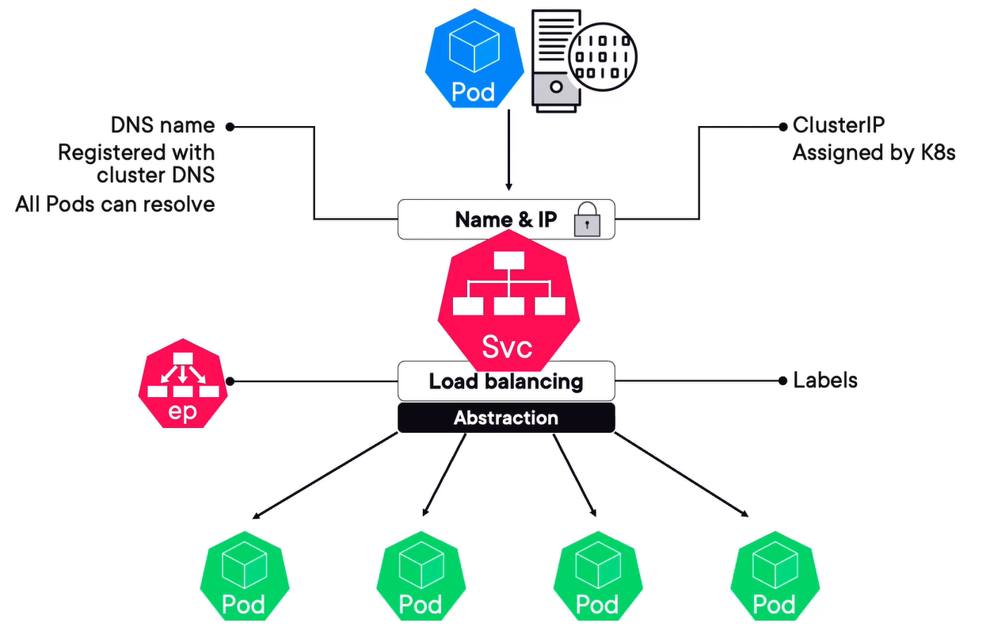
Service

Slide 11
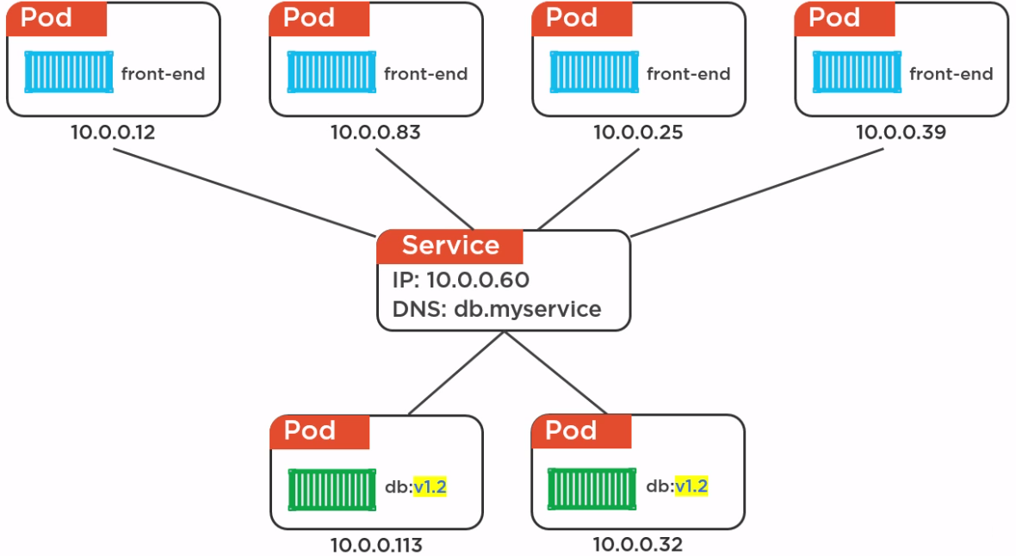
Service
10.1.23.10
DNS:myapp.service.com

Slide 12
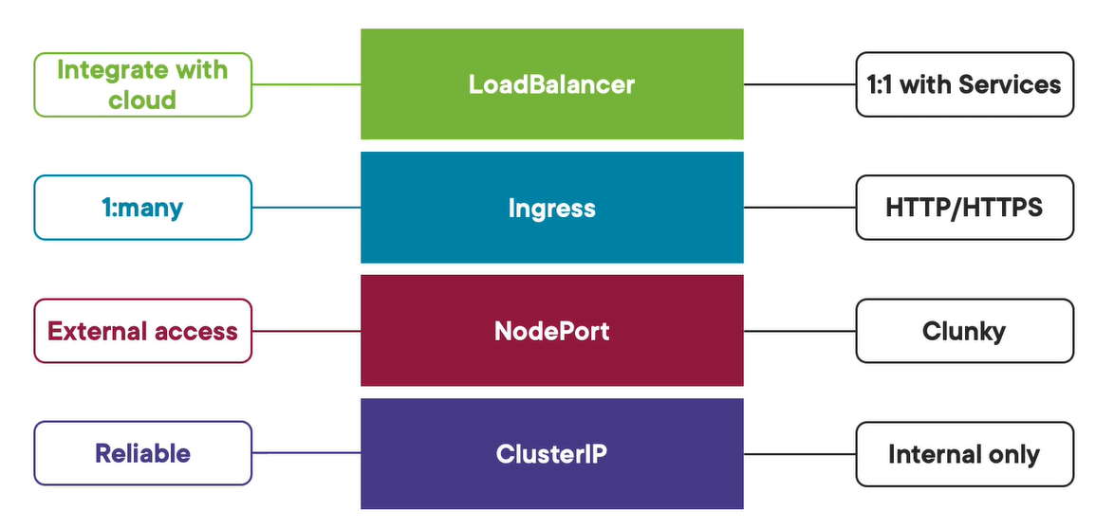

Ingress

Slide 13
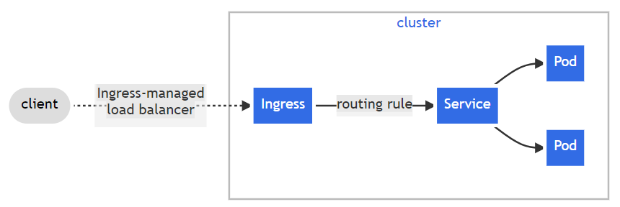
Ingress exposes HTTP and HTTPS routes from outside the cluster to services within the cluster. Traffic routing is controlled by rules defined on the Ingress resource.
Ingress

Slide 14
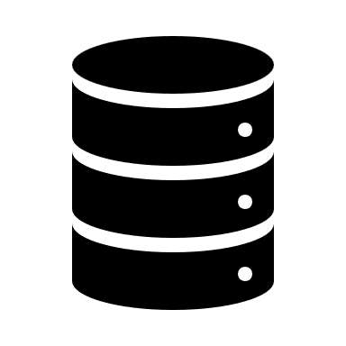
DaemonSets:
Ensures that all or some of the nodes run a POD for the required service / application.
This is effectively a Init Daemon inside your cluster.
Example Workload:
Kube-proxy – Cluster network service
Log collectors
Metric Servers
Resource monitoring agents
Storage daemons
Update strategy: RollingUpdate and OnDelete
StatefulSet:
StatefulSet is the workload API object used to manage stateful applications.
Manages the deployment and scaling of a set of Pods, and provides guarantees about the ordering and uniqueness of these Pods.
DaemonSet and StatefulSet

Slide 15
ConfigMaps: A ConfigMap is an API object used to store non-confidential data in key-value pairs.
Key value pairs exposed into a container based application’s configuration setting.
Mostly used for defining applications or environment specific settings.
Maximizes the container based image portability.
Define Environment variables or files.
ConfigMaps can be defined inside a POD as Environment variables or Volumes and files
Secrets: A Secret is an object that contains a small amount of sensitive data such as a password, a token, or a key
Secret object types:
Opaque (generic), Service Account token, Docker config, Basic Authentication (username/psw), SSH Auth, TLS, Bootstrap Token.
Stored in default base24 coded format
Can be encrypted
Secrets and ConfigMaps

Slide 16
On the Cluster Node, the PODs are allowed to request for a specific size of resources (CPU, Memory, Page size). However, we can set a limit for the resources to be used by a POD as well.
CPU Resource Unit: 1.0 CPU unit is equivalent to 1 physical or virtual core CPU.
0.1 is equivalent to 100 millicpus.
Memory Resource Unit: expressed in bytes.
Ki, Mi, Gi, Ti, Pi, Ei
POD Resource - Request and Limits

Slide 17
Three type of Autoscaling techniques are available in Kubernetes.
Horizontal POD Autoscaler (HPA): Number of POD are scaled UP or Down depending upon resource utilization (Memory and/or CPU)
Vertical POD Autoscaler (VPA): Resources allocated to the POD are increased / decreased using Vertical POD Autoscaler.
Cluster Autoscaler: Capacity of Cluster that is, the number of Nodes are scaled up or down depending upon the resource utilization on a Node.
Autoscaling in Kubernetes

Slide 18
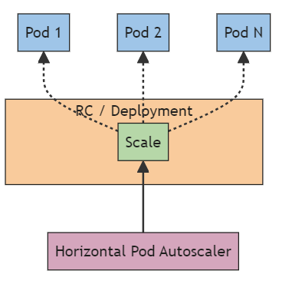
HorizontalPodAutoscaler automatically updates a workload resource (such as a Deployment or StatefulSet), with the aim of automatically scaling the workload to match demand.
Horizontal scaling means that the response to increased load is to deploy more Pods. Horizontal pod autoscaling does not apply to objects that can't be scaled (for example: a DaemonSet.)
Horizontal POD Autoscaler (HPA)

Slide 19
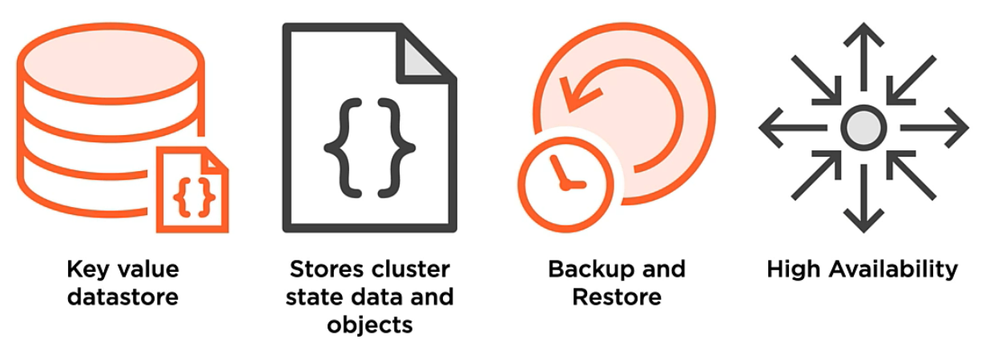
Maintaining etcd

Slide 20
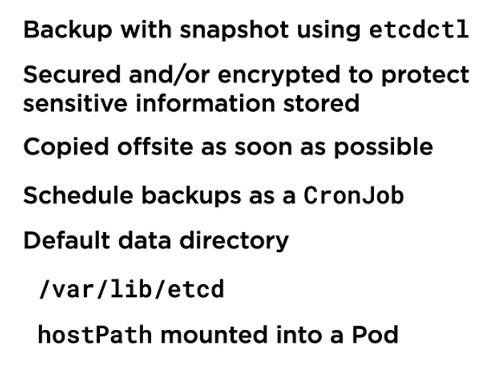
Maintaining etcd using etcdctl utility

Slide 21
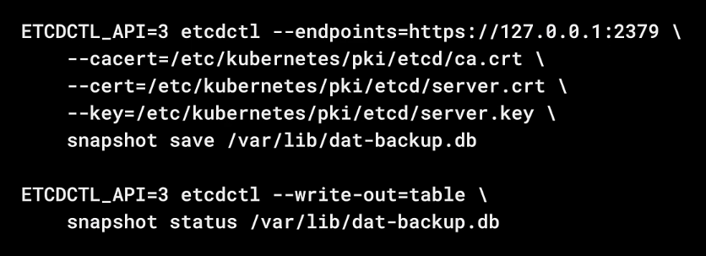
How do we backup etcd?
Maintaining etcd using etcdctl utility

Slide 22
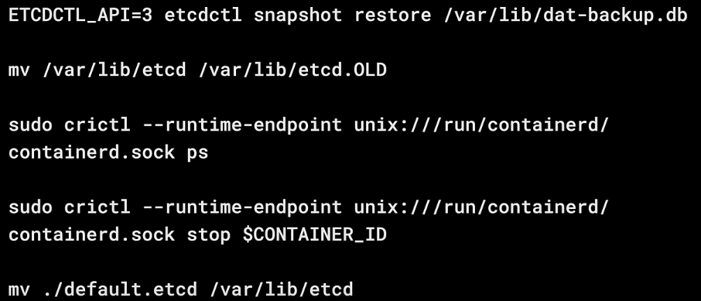
How do we restore the Backup: Applicable for single server POD based etcd
Maintaining etcd using etcdctl utility

